Slide 1
Question Answering
CPSC 677 Advanced Natural Language Processing
Presented by Talley Amir
11 October 2018

Slide 2
Roadmap
What is Question Answering?
A Brief History
TREC
IBM Watson
Presentation of Papers
SQuAD (Stanford University)
QANTA (University of Maryland, College Park)
Answering Complex Questions Using Open Information Extraction (Aristo at Allen Institute for Artificial Intelligence)
Additional Areas of Exploration
Discussion Questions

Slide 3
What is Question Answering?

Slide 4
What is Question Answering?
Question answering (QA), is the problem of systematically deriving an answer to a question asked in a natural language based on a knowledge source.
Hermann, Karl M. “Deep Learning for Natural Language Processing: Question Answering.” Google DeepMind. 4 March 2017.

Slide 5
What is Question Answering?
Information retrieval (IR)-based QA
Uses phrases in the question to search for keywords in vast data sources (e.g. documents in a reserve, websites on the Internet) that may contain the answer to the question. The answer-candidates are then ranked based on various metrics pertaining to the quality and relevance of the answers.
Knowledge-based QA
Translates the question into a semantic representation compatible with a database wherein the answer to the question lies. The semantic representation is then made as a query to the database, and the query-answer is then converted to a natural-language response.
Jurafsky, Daniel. Martin, James H. “Speech and Language Processing.” Third Edition. 15 August 2018: p. 376.

Slide 6
What is Question Answering?
Metrics of successful QA modeling:
Relevance
Correctness
Conciseness
Completeness
Coherence
Justification
Current limitations:
Breadth versus depth
Pasupat, Panupong. “WikiTableQuestions: A Complex Real-World Question Answering Dataset.” The Stanford NLP Group. 11 February 2016.
L. Hirschman and R. Gaizauskas, ``Natural language question answering: the view from here,'' Natural Language Engineering, vol. 7, no. 4,
pp. 275-300, 2001.

Slide 7
A Brief History

Slide 8
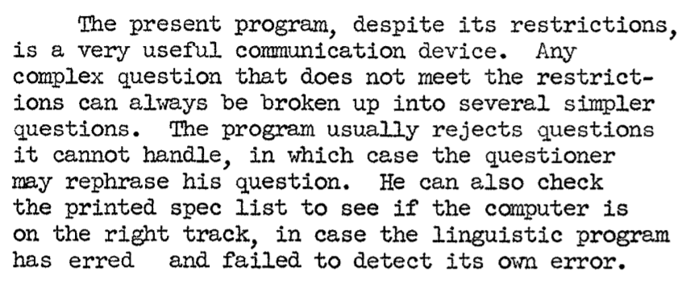
Early Stages
BASEBALL
Presented in “Baseball: An Automatic Question-Answerer,” from Stanford (1961).
The question was read in via punch cards and then processed:
Data (baseball statistics) stored in a hierarchical structure.
Used notion of syntax parsing and dictionary lookup to answer questions.
Bert F. Green, Jr., Alice K. Wolf, Carol Chomsky, and Kenneth Laughery. 1961. Baseball: an automatic question-answerer. In Papers presented at the May 9-11, 1961, western joint IRE-AIEE-ACM computer conference. ACM, New York, NY, USA, 219-224.

Slide 9
TREC
Co-sponsored by NIST and the U.S. Department of Defense
Annual conference, began in 1992.
QA track began in 1999.
Goals:
Provide a space for sharing new ideas in the field of IR.
Make it easier to translate advancements in knowledge to technological implementation (for commercial or other use).
Standardize evaluation for various areas of IR.
Some current (2018) tracks:
Real time summarization track
News track
Complex answer retrieval track
Text REtrieval Conference
https://trec.nist.gov/overview.html

Slide 10
(TREC): Question Answering Track
Types of questions:
Formed on corpuses (news, Wikipedia, etc.).
In 2015, started LiveQA.
The TREC QA test set consists of sets of questions.
Various formats and scoring methods.
In early years, competing models would offer five suggested answers per question, ranked.
Used Mean Reciprocal Rank (MRR) to score answers.
Later on (after 2002), only one answer was permitted, associated with a level of confidence.
Klein, Dan. “Natural Language Processing: Question Answering.” UC Berkeley.

Slide 11
(TREC): Question Answering Track
Performance:
On average, models rank the correct answer in 4th-5th place using TREC documents as training data to answer these questions.
When larger data sets are used for training (e.g. the web), this improves to 2nd-3rd place.
Difference in performance: TREC limited KB size and structure of answers.
Limited extensibility: Only works for factoid-based QA.
Klein, Dan. “Natural Language Processing: Question Answering.” UC Berkeley.

Slide 12
(TREC): Question Formulation and Scoring
TREC poses various challenges:
Question series
Factoid questions
List questions
Temporal inference
Definitions
Common sense reasoning
Complex interactive QA (ciQA)
Dang, Hoa Trang. “Text REtrieval Conference (TREC) Question Answering Tasks and Evaluation Methods.”National Institute of Standards and Technology. April 27, 2007.

Slide 13
(TREC): Question Formulation and Scoring
Example of question series:
TARGET: Lady Bird won the Golden Globe.
Q1 (FACTOID): Who directed Lady Bird?
Q2 (FACTOID): Who is the lead actress?
Q3 (LIST): Who was nominated for the Best Motion Picture?
Q4 (OTHER): Other
Intended to simulate “a conversation.”
Evaluation of question series:
Response to each question is a tuple of the document ID and the answer (or list), or NIL.
For each tuple, score 1 if human assessors grade the answer “globally correct,” else 0.
Scoring options: (i) wrong, (ii) unsupported, (iii) inexact, (iv) locally correct, (v) globally correct.
For “OTHER”: Label as “vital” or “okay.”
Overall score combines component scores.
Evaluation requires “exact” answers, whereas other evaluation methods are more lenient.
Dang, Hoa Trang. “Text REtrieval Conference (TREC) Question Answering Tasks and Evaluation Methods.”National Institute of Standards and Technology. April 27, 2007.

Slide 14
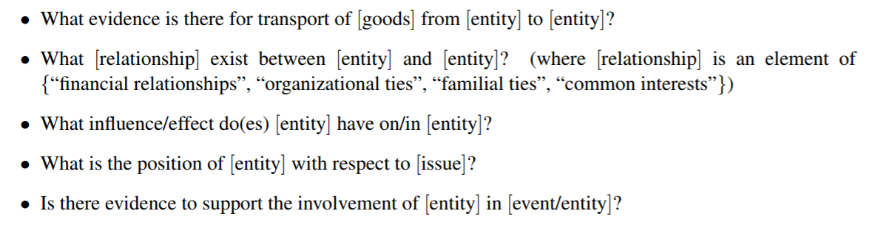
(TREC): Question Formulation and Scoring
ciQA question structure:
Template and narrative.
Templates (2007):
Success of ciQA track:
Meant to be more interactive than series
Too interactive, very limited success.
Dang, Hoa Trang. “Text REtrieval Conference (TREC) Question Answering Tasks and Evaluation Methods.”National Institute of Standards and Technology. April 27, 2007.
Notes:
http://www.cs.columbia.edu/~ani/papers/pyramid.pdf
https://ws680.nist.gov/publication/get_pdf.cfm?pub_id=890018

Slide 15
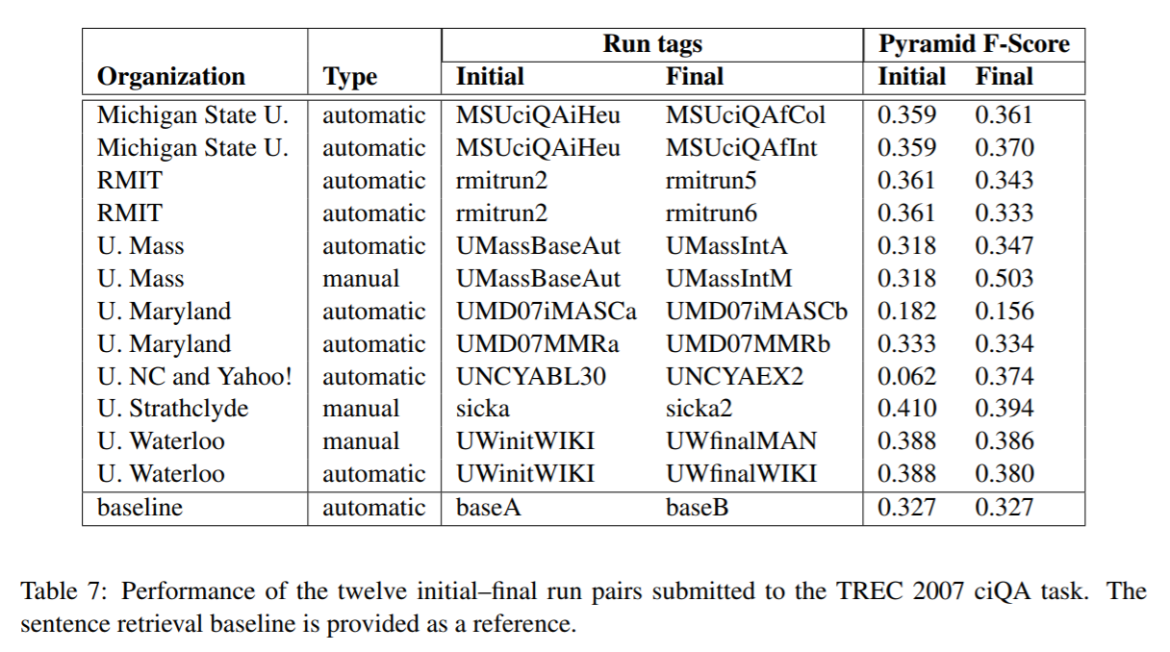
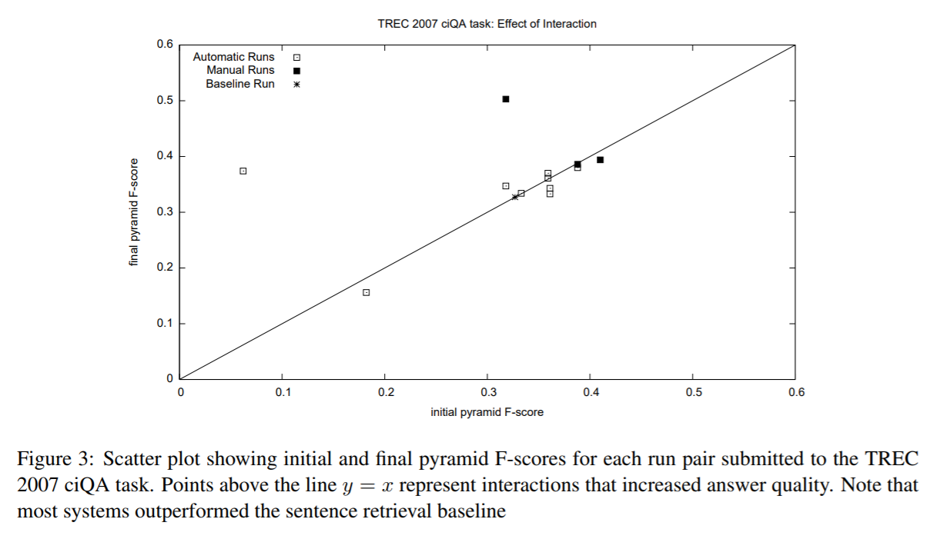
(TREC): Performance and Summary
ciQA performance (2007):
Dang, et al.. “Overview of the TREC 2007 Question Answering Track.” National Institute of Standards and Technology. 2007.

Slide 16
TREC
Complex Answer Retrieval (CAR) Track
Non-interactive.
Example application: User wants to buy a new product but wants evaluation.
Should be able to query “product features” and get a summary/analysis.
Task: Passage ranking and entity ranking.
Given an article stub, identify the most relevant entities (entry in passage) or passages, plus supporting evidence.
Evaluation: 0-4 relevance score.
This year
http://trec-car.cs.unh.edu/
Notes:
“In the passage ranking task, entities are omitted. In the entity ranking task, the entity must be given, and optionally, complemented with a passage that serves as provenance for why the entity is relevant. If the passage is omitted, it will be replaced with the first paragraph from the entity’s article.” http://trec-car.cs.unh.edu/

Slide 17
IBM Watson
A question answering system originally devised to answer Jeopardy! questions.
In 2011, Watson indeed did beat human competitors in the televised trivia game.
Later extended and even commercialized.
In 2013, in a partnership with Memorial Sloan Kettering, Watson used to make medical diagnoses with better than human accuracy. It provides:
Answer
Confidence notion
Supporting evidence
IBM’s DeepQA Project
Upbin, Bruce. “IBM’s Watson Gets Its First Piece of Business in Healthcare.” Forbes. 8 February 2013.
Wikipedia contributors. "Watson (computer)." Wikipedia, The Free Encyclopedia. Wikipedia, The Free Encyclopedia, 4 Oct. 2018.

Slide 18
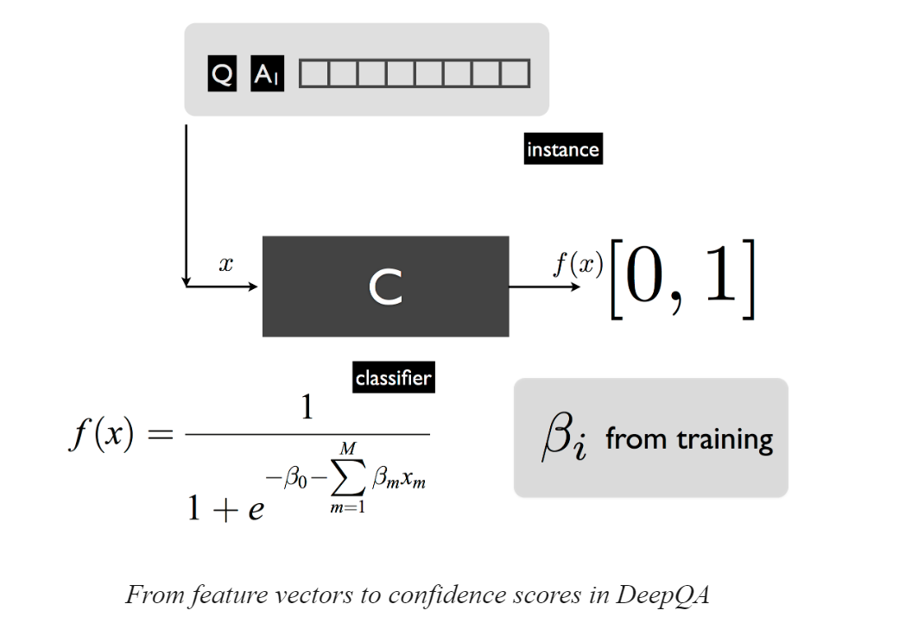
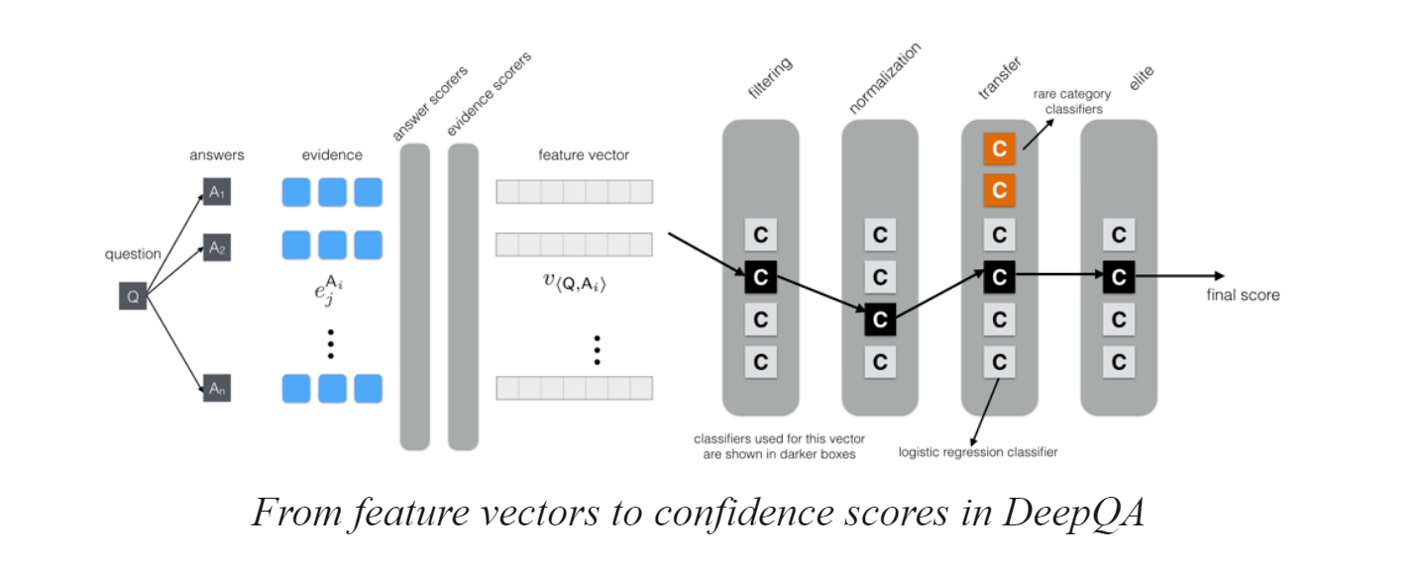
IBM Watson
DeepQA:
IBM’s DeepQA Project
“Watson’s DeepQA Architecture.” Stanford Encyclopedia of Philosophy. 2016.

Slide 19
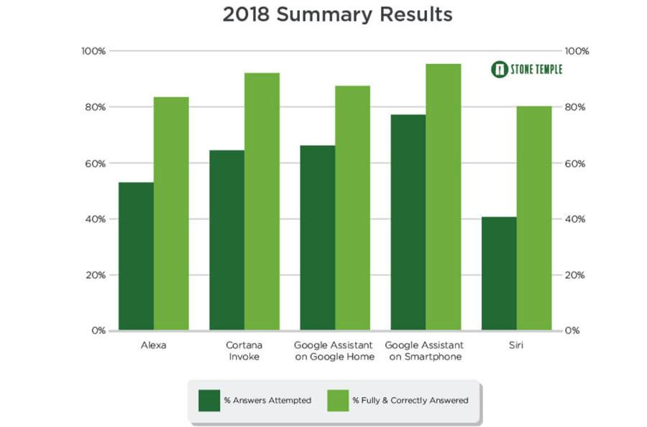
Virtual Assistants
Applications:
Command execution.
Play music, set an alarm
Simple question answering.
What is the weather like today?
Performance:
Murnane, Kevin. “Dumb And Dumber: Comparing Alexa, Siri, Cortana And The Google Assistant.” Forbes. 3 May 2018.

Slide 20
Presentation of Papers

Slide 21
(SQuAD): 100,000+ Questions for Machine Comprehension of Text
Pranav Rajpurkar, Jian Zhang, Konstantin Lopyrev, and Percy Liang
With Stanford University

Slide 22
(SQuAD): 100,000+ Questions for Machine Comprehension of Text
Application: Reading comprehension, specifically applied to question-answer pairs from Wikipedia articles (cultivated in this dataset).
Challenge: Manually develop a large reading comprehension dataset of quality questions and answers, and derive a model for learning on that dataset.
Implementation: This model uses both dependency and constituency trees, as well as a strong logistic regression model.
Rajpurkar, Pranav. Zhang, Jian. Lopyrev, Konstantin. Liang, Percy. “SQuAD: 100,000+ Questions for Machine Comprehension of Text.” Stanford University, Computer Science Department. 11 October 2016.

Slide 23
(SQuAD): 100,000+ Questions for Machine Comprehension of Text
Existing Datasets:
Hirschman et al. (1999)
Later improved: Riloff and Thelen (2000); Ng et al. (2000)
Richardson et al. (2013): MCTest
Later improved: Narasimhan and Barzilay (2015); Sachan et al. (2015); Wang et al. (2015)
Both data sets are too small to extend to more “expressive” QA modeling systems.
Rajpurkar, Pranav. Zhang, Jian. Lopyrev, Konstantin. Liang, Percy. “SQuAD: 100,000+ Questions for Machine Comprehension of Text.” Stanford University, Computer Science Department. 11 October 2016.

Slide 24
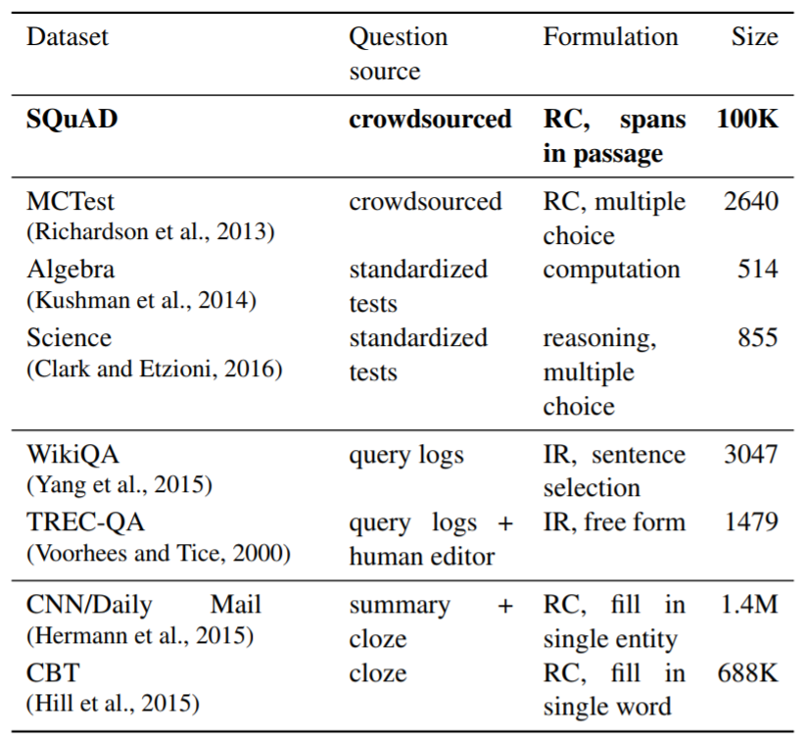
(SQuAD): 100,000+ Questions for Machine Comprehension of Text
Rajpurkar, Pranav. Zhang, Jian. Lopyrev, Konstantin. Liang, Percy. “SQuAD: 100,000+ Questions for Machine Comprehension of Text.” Stanford University, Computer Science Department. 11 October 2016.
Notes:
(Table): “A survey of several reading comprehension and question answering datasets. SQuAD is much larger than all datasets except the semi-synthetic cloze-style datasets, and it is similar to TREC-QA in the open-endedness of the answers.” Ibid.

Slide 25
(SQuAD): 100,000+ Questions for Machine Comprehension of Text
How questions were formulated:
Randomly selected 536 of the 10,000 most visited Wikipedia pages.
Passages of sufficient length were divided into: training set, development set, or test set.
Crowdworkers generated questions that could be answered with a span of text from the passage.
Other crowdworkers were then used to select alternate answer choices (spans from the text)
Rajpurkar, Pranav. Zhang, Jian. Lopyrev, Konstantin. Liang, Percy. “SQuAD: 100,000+ Questions for Machine Comprehension of Text.” Stanford University, Computer Science Department. 11 October 2016.

Slide 26
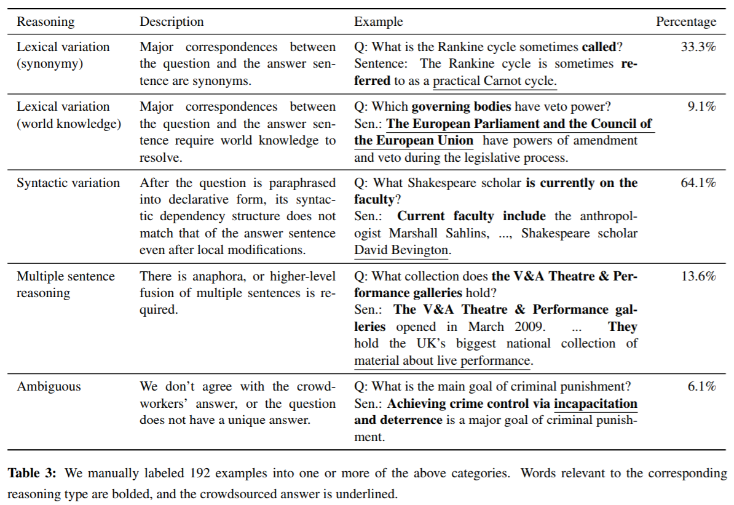
(SQuAD): 100,000+ Questions for Machine Comprehension of Text
Rajpurkar, Pranav. Zhang, Jian. Lopyrev, Konstantin. Liang, Percy. “SQuAD: 100,000+ Questions for Machine Comprehension of Text.” Stanford University, Computer Science Department. 11 October 2016.
Notes:
(Table): “A survey of several reading comprehension and question answering datasets. SQuAD is much larger than all datasets except the semi-synthetic cloze-style datasets, and it is similar to TREC-QA in the open-endedness of the answers.” Ibid.

Slide 27
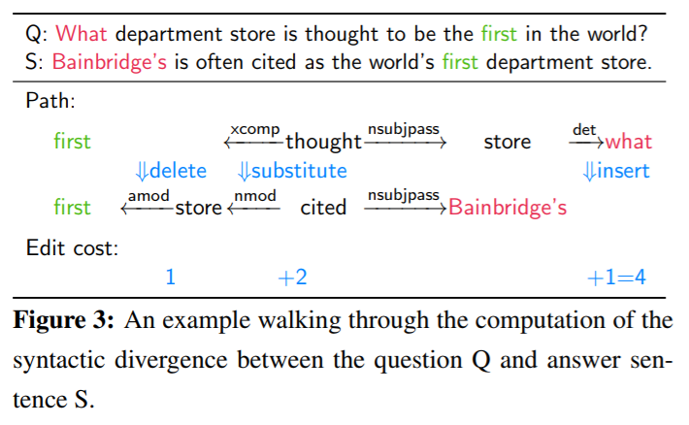
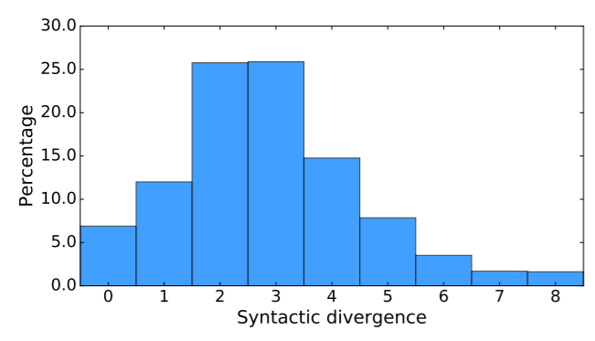
(SQuAD): 100,000+ Questions for Machine Comprehension of Text
Measurement of syntactic divergence:
Rajpurkar, Pranav. Zhang, Jian. Lopyrev, Konstantin. Liang, Percy. “SQuAD: 100,000+ Questions for Machine Comprehension of Text.” Stanford University, Computer Science Department. 11 October 2016.

Slide 28
(SQuAD): 100,000+ Questions for Machine Comprehension of Text
Method:
Develop a set of candidate sentence spans using Stanford CoreNLP.
Apply sliding window approach (Richardson et al.) to get best candidates.
Apply logistic regression model.
Evaluate performance.
Rajpurkar, Pranav. Zhang, Jian. Lopyrev, Konstantin. Liang, Percy. “SQuAD: 100,000+ Questions for Machine Comprehension of Text.” Stanford University, Computer Science Department. 11 October 2016.

Slide 29
(SQuAD): 100,000+ Questions for Machine Comprehension of Text
Logistic regression model:
Candidate answers were evaluated based on certain features.
The model was then trained on the answer choices using AdaGrad (gradient-based optimization algorithm).
L₂ regularization is used in training the model.
Features:
Matching Word/Bigram Frequencies
Root Match
Lengths
Span Word Frequencies
Constituent Label
Span POS Tags
Lexicalized
Dependency Tree Paths
Rajpurkar, Pranav. Zhang, Jian. Lopyrev, Konstantin. Liang, Percy. “SQuAD: 100,000+ Questions for Machine Comprehension of Text.” Stanford University, Computer Science Department. 11 October 2016.

Slide 30
(SQuAD): 100,000+ Questions for Machine Comprehension of Text
Experiments and results:
Used exact match and F1 score to evaluate accuracy.
The results of the logistic regression model were compared with both baseline performance and human performance.
A procedure called “feature ablations” was used to determine on which features the model performed the highest.
The authors also analyzed performance based on answer type.
Rajpurkar, Pranav. Zhang, Jian. Lopyrev, Konstantin. Liang, Percy. “SQuAD: 100,000+ Questions for Machine Comprehension of Text.” Stanford University, Computer Science Department. 11 October 2016.

Slide 31
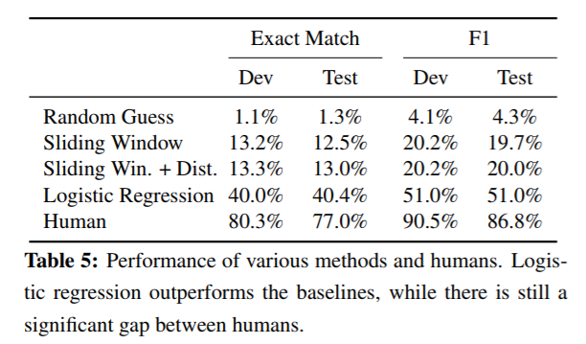
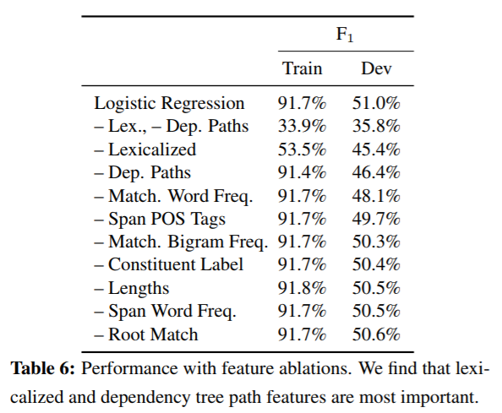
(SQuAD): 100,000+ Questions for Machine Comprehension of Text
Rajpurkar, Pranav. Zhang, Jian. Lopyrev, Konstantin. Liang, Percy. “SQuAD: 100,000+ Questions for Machine Comprehension of Text.” Stanford University, Computer Science Department. 11 October 2016.

Slide 32
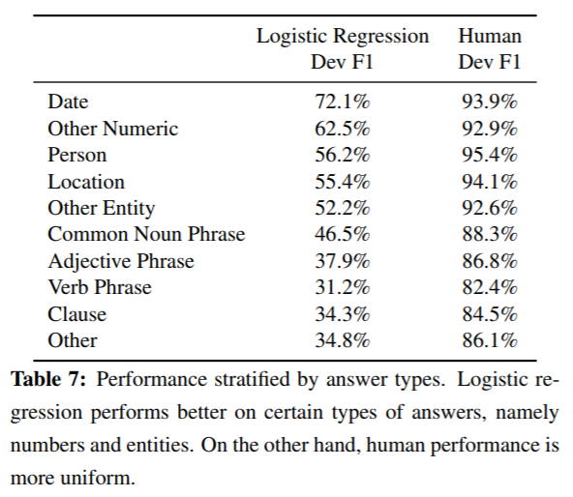
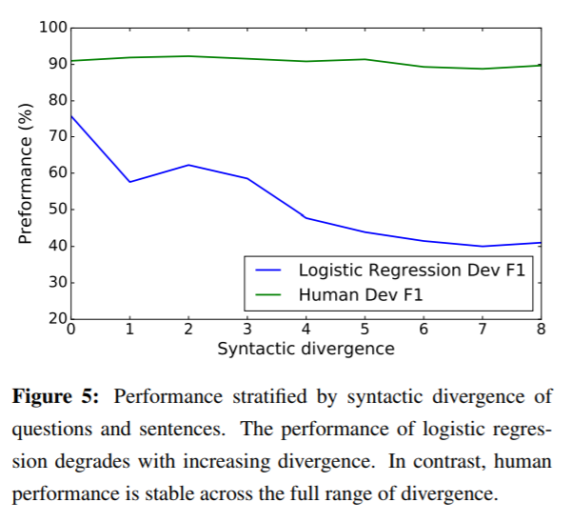
(SQuAD): 100,000+ Questions for Machine Comprehension of Text
Rajpurkar, Pranav. Zhang, Jian. Lopyrev, Konstantin. Liang, Percy. “SQuAD: 100,000+ Questions for Machine Comprehension of Text.” Stanford University, Computer Science Department. 11 October 2016.

Slide 33
(SQuAD): 100,000+ Questions for Machine Comprehension of Text
Summary:
This paper contributes a question answering dataset based on Wikipedia articles that has crowdsourced question-answer pairs.
This dataset is public and many other works use it to test their own models.
The logistic regression model outperforms the baseline, but is far from human performance.
However, since the paper was published in 2016, the gap between this model’s performance and human performance has more than halved.
Rajpurkar, Pranav. Zhang, Jian. Lopyrev, Konstantin. Liang, Percy. “SQuAD: 100,000+ Questions for Machine Comprehension of Text.” Stanford University, Computer Science Department. 11 October 2016.

Slide 34
A Neural Network for Factoid Question Answering Over Paragraphs
Mohit Iyyer, Jordan Boyd-Graber, Leonardo Claudino, Richard Socher, and Hal Daum´e III
With University of Maryland

Slide 35
(QANTA): A Neural Network for Factoid Question Answering Over Paragraphs
Application: Answering questions from Quiz Bowl, a high school trivia competition.
The questions in this competition are pyramidal, meaning that the first clues given are very difficult, and later clues progressively become more leading.
Challenge: Develop a model that answers questions based on information that contains very limited key words pertaining to the answer.
Implementation: This model uses a dependency-tree recurrent neural net (DT-RNN) to condense meaning of phrases into “hidden vectors.”
Iyyer, Mohit et al. “A Neural Network for Factoid Question Answering Over Paragraphs.” 2014.

Slide 36
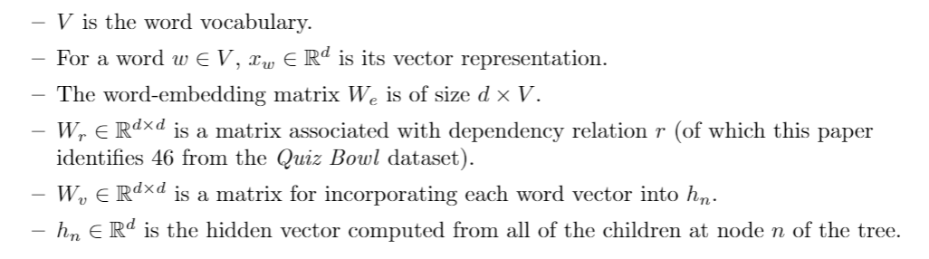
(QANTA): A Neural Network for Factoid Question Answering Over Paragraphs
Iyyer, Mohit et al. “A Neural Network for Factoid Question Answering Over Paragraphs.” 2014.

Slide 37
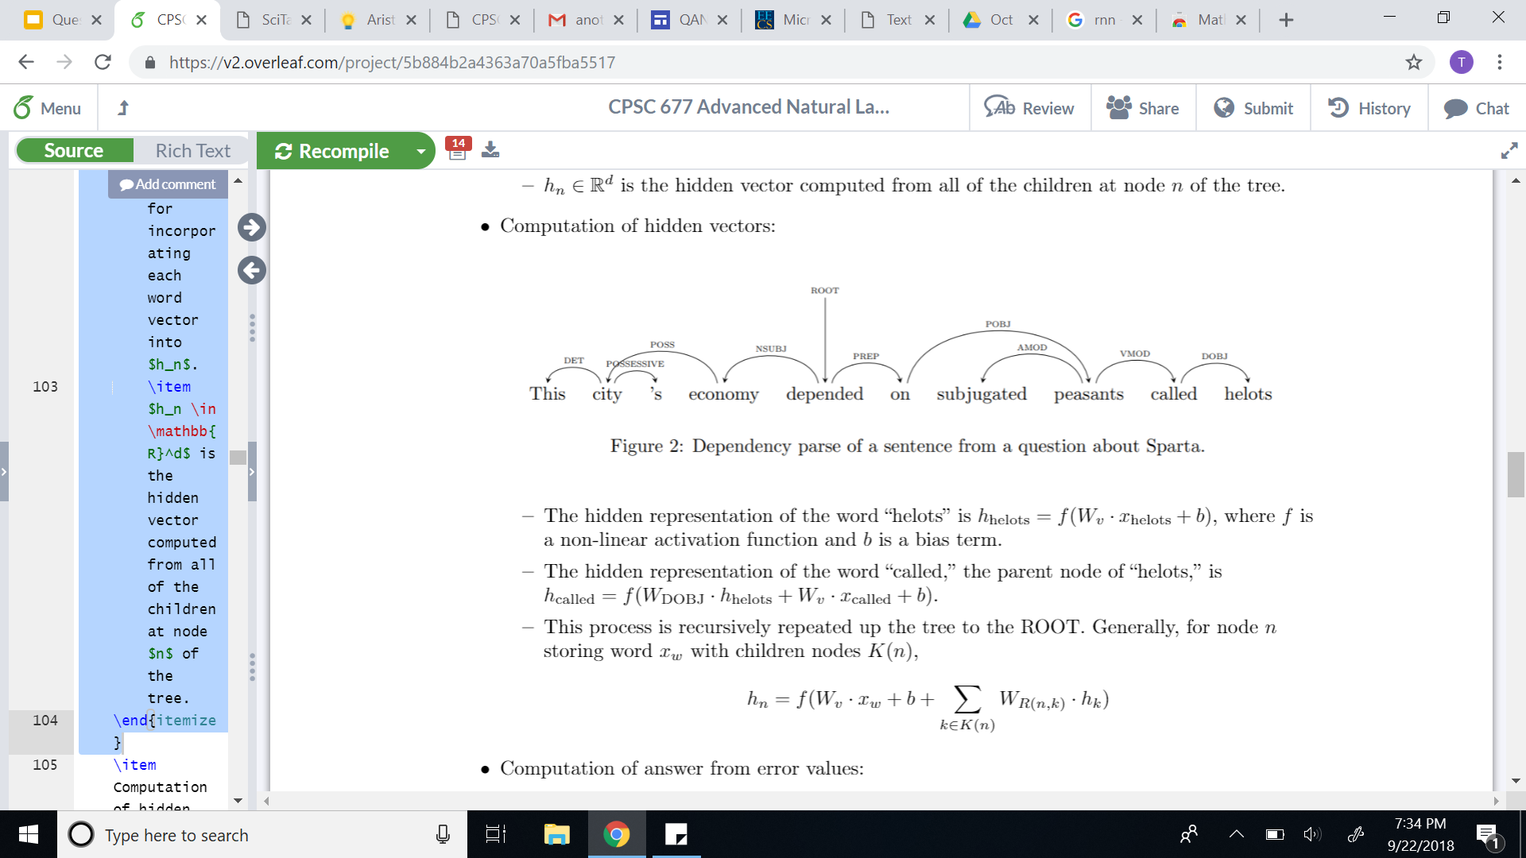
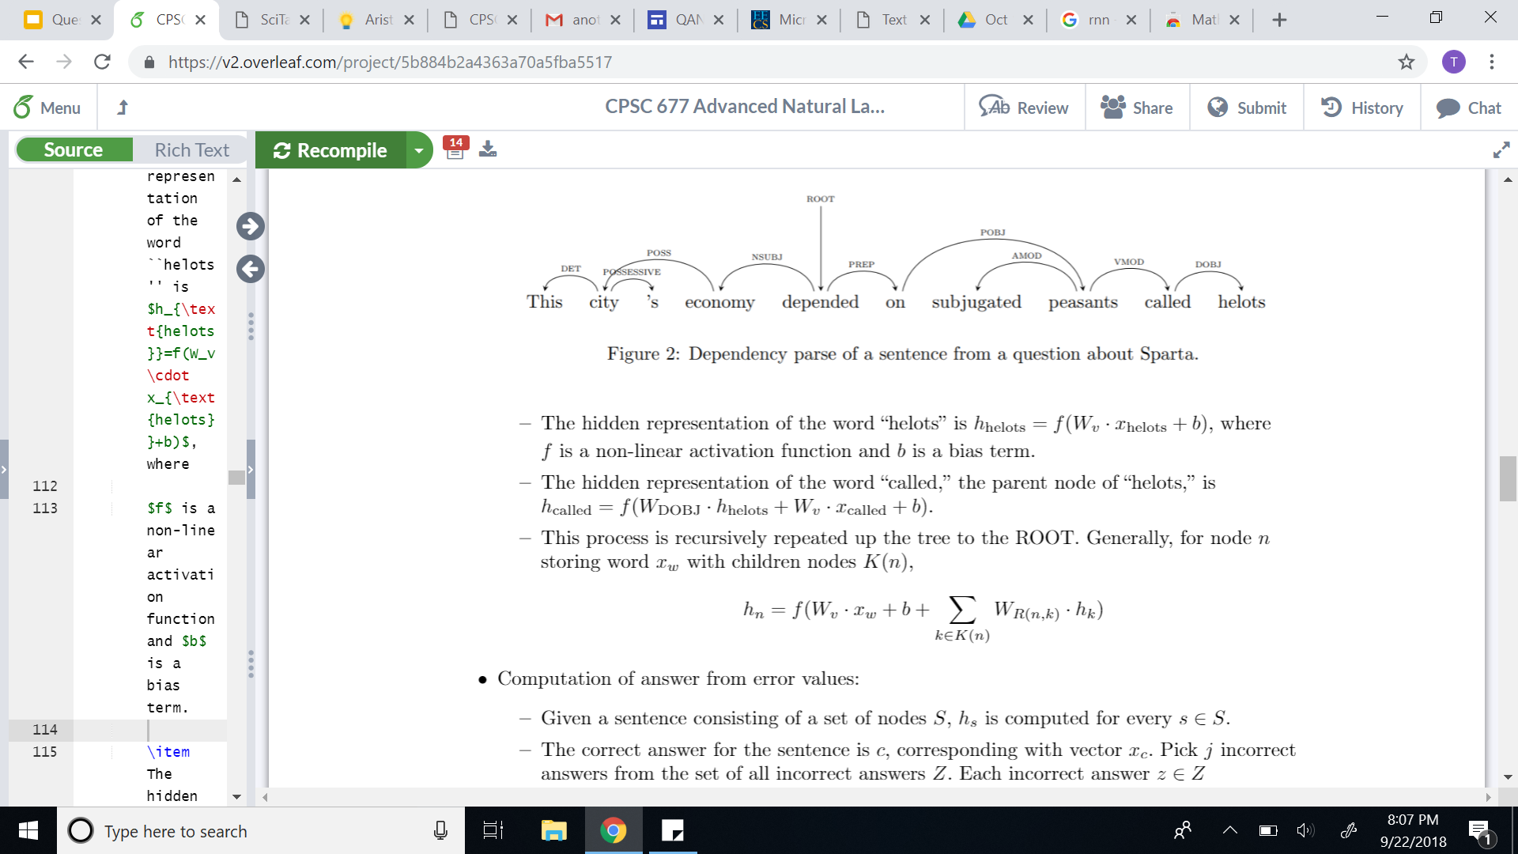
(QANTA): A Neural Network for Factoid Question Answering Over Paragraphs
Recursive computation of hidden vectors:
Iyyer, Mohit et al. “A Neural Network for Factoid Question Answering Over Paragraphs.” 2014.

Slide 38
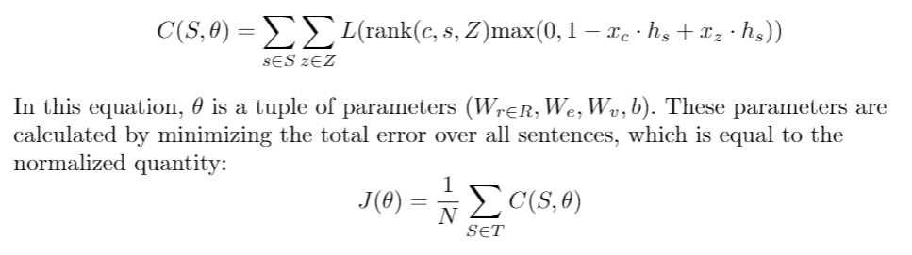
(QANTA): A Neural Network for Factoid Question Answering Over Paragraphs
Computation of parameters from error minimization:
Iyyer, Mohit et al. “A Neural Network for Factoid Question Answering Over Paragraphs.” 2014.

Slide 39
(QANTA): A Neural Network for Factoid Question Answering Over Paragraphs
Experiments:
QANTA was trained on questions used in Quiz Bowl tournaments between 1998 and 2013.
Only questions from the History and Literature sections were used (as these were the largest datasets).
Both questions and answers were altered to make keyword recognition more feasible (using Whoosh).
Iyyer, Mohit et al. “A Neural Network for Factoid Question Answering Over Paragraphs.” 2014.

Slide 40
(QANTA): A Neural Network for Factoid Question Answering Over Paragraphs
Sample QuizBowl question:
These substances can use either using a ping-pong mechanism or a ternary complex intermediate.
https://docs.google.com/viewer?a=v&pid=sites&srcid=d2xwcy5uZXR8d2xocy1xdWl6LWJvd2x8Z3g6Mzk2ZmQ5ZTJiMmRjNzljMg

Slide 41
(QANTA): A Neural Network for Factoid Question Answering Over Paragraphs
Sample QuizBowl question:
These substances can use either using a ping-pong mechanism or a ternary complex intermediate.
One model of them defines the parameters K-m and V-max and uses a steady-state approximation.
https://docs.google.com/viewer?a=v&pid=sites&srcid=d2xwcy5uZXR8d2xocy1xdWl6LWJvd2x8Z3g6Mzk2ZmQ5ZTJiMmRjNzljMg

Slide 42
(QANTA): A Neural Network for Factoid Question Answering Over Paragraphs
Sample QuizBowl question:
These substances can use either using a ping-pong mechanism or a ternary complex intermediate.
One model of them defines the parameters K-m and V-max and uses a steady-state approximation.
They can be inhibited non-competitively and competitively, and the change in their structure during substrate binding is described by the (*) induced-fit model. They can be allosterically regulated and perform their action at their active site. For 10 points, name these proteins that catalyze reactions.
https://docs.google.com/viewer?a=v&pid=sites&srcid=d2xwcy5uZXR8d2xocy1xdWl6LWJvd2x8Z3g6Mzk2ZmQ5ZTJiMmRjNzljMg

Slide 43
(QANTA): A Neural Network for Factoid Question Answering Over Paragraphs
Sample QuizBowl question:
ANSWER: Enzymes
https://docs.google.com/viewer?a=v&pid=sites&srcid=d2xwcy5uZXR8d2xocy1xdWl6LWJvd2x8Z3g6Mzk2ZmQ5ZTJiMmRjNzljMg

Slide 44
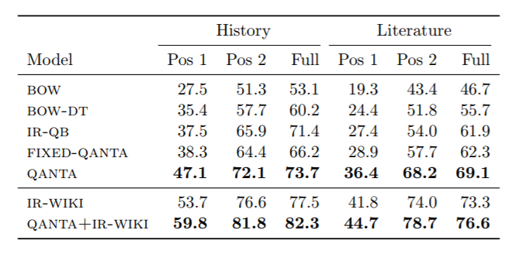
(QANTA): A Neural Network for Factoid Question Answering Over Paragraphs
Performance:
Iyyer, Mohit et al. “A Neural Network for Factoid Question Answering Over Paragraphs.” 2014.

Slide 45
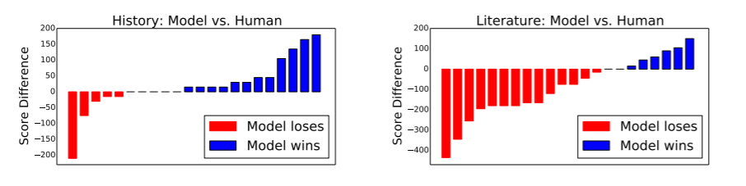
(QANTA): A Neural Network for Factoid Question Answering Over Paragraphs
Performance:
Iyyer, Mohit et al. “A Neural Network for Factoid Question Answering Over Paragraphs.” 2014.

Slide 46
(QANTA): A Neural Network for Factoid Question Answering Over Paragraphs
Summary:
QANTA outperforms BOW and IR models in answering factoid, pyramidal questions.
This paper contributes a model that understands and applies sentence compositionality to question answering.
Iyyer, Mohit et al. “A Neural Network for Factoid Question Answering Over Paragraphs.” 2014.

Slide 47
Answering Complex Questions Using Open Information Extraction
Tushar Khot, Ashish Sabharwal, Peter Clark
With Aristo Team at Allen Institute of Artificial Intelligence

Slide 48
(Aristo): Answering Complex Questions Using Open Information Extraction
Application: Use open information extraction (Open IE) to answer complex questions.
Challenge: Most Open IE frameworks support factoid question answering (simple information retrieval), but this paper aims to extend this framework to answer more complex questions.
Implementation: This paper offers an inference model for reasoning over Open IE.
Khot, et al. “Answering Complex Questions Using Open Information Extraction.” ACL 2017. 19 April 2017.

Slide 49
(Aristo): Answering Complex Questions Using Open Information Extraction
What is Open IE:
These are knowledge bases formatted as a set of tuples.
Tuples represent relationships between words in text.
These relationships are typically binary.
The relation need not be specified in advance.
Examples:
“The dog barks in the park.” → (The dog; barks in; the park)
“The woman drove the car.” → (The woman; drove; the car)
“Stanford Open Information Extraction” The Stanford Natural Language Processing Group. Retrieved from: https://nlp.stanford.edu/software/openie.html#Usage

Slide 50
(Aristo): Answering Complex Questions Using Open Information Extraction
Pros:
The structure is flexible.
Easy to answer factoid questions (search or pattern match).
Cons:
Expensive storage overhead.
Typically these sets are domain-specific.
No complex relationships between or groupings of the tuples
Khot, et al. “Answering Complex Questions Using Open Information Extraction.” ACL 2017. 19 April 2017.

Slide 51
(Aristo): Answering Complex Questions Using Open Information Extraction
TableILP system by Khashabi et al. (2016):
Also developed by Allen AI.
Applies integer linear programming (ILP) to a set of tables containing relationships between terms in a set of questions and answers.
ILP is then used to find the optimal answer related to a question.
This paper (Aristo) extends this technique to OpenIE tuples.
Other previous works:
Struggle to balance breadth and depth.
Khot, et al. “Answering Complex Questions Using Open Information Extraction.” ACL 2017. 19 April 2017.

Slide 52
(Aristo): Answering Complex Questions Using Open Information Extraction
Tuple generation:
Formatted: (subject; predicate; objects), zero or more objects.
Derived from corpora in Clark et al. (2016).
These are unedited exam questions from NY Regents Science Exam.
Approximately 80,000 sentences in total.
Training question set Q_{tr} consists of multiple choice questions.
For each multiple choice question (q, A = {a_{i}}), take top 200 responses from Elasticsearch query to construct tuples using Open IE v4.
Clark, et al. 2016. “Combining retrieval, statistics, and inference to answer elementary science questions.” The Thirtieth AAAI Conference on Artificial Intelligence (AAAI'16). AAAI Press 2580-2586.
Khot, et al. “Answering Complex Questions Using Open Information Extraction.” ACL 2017. 19 April 2017.

Slide 53
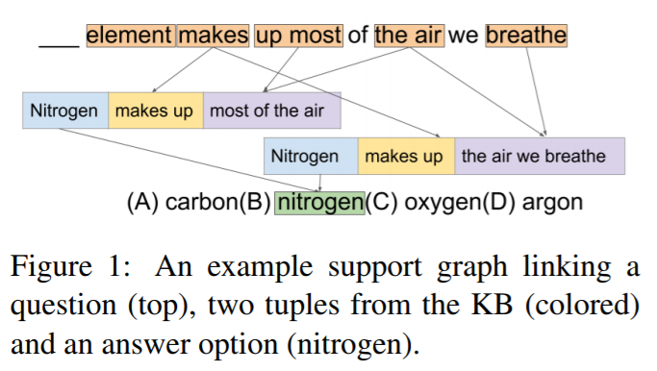
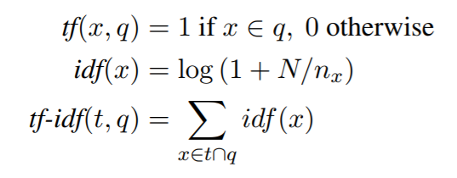
(Aristo): Answering Complex Questions Using Open Information Extraction
Given (q, A = {a_{i}}):
TF-IDF Score:
Take the 50 tuples with the highest score.
Khot, et al. “Answering Complex Questions Using Open Information Extraction.” ACL 2017. 19 April 2017.

Slide 54
(Aristo): Answering Complex Questions Using Open Information Extraction
Support graph and search:
Nodes are qterms (terms in the question), tuple fields, and answer choices.
Edges are directed, either from qterm to tuple field, or tuple field to answer.
Edges (and nodes) are labeled as “active” based on their weights (and the weights of the edges connecting them).
The problem is to find the optimal active subgraph.
Khot, et al. “Answering Complex Questions Using Open Information Extraction.” ACL 2017. 19 April 2017.

Slide 55
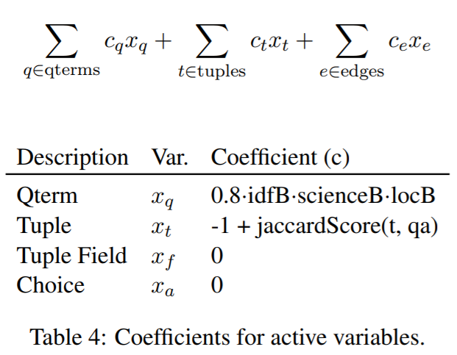
(Aristo): Answering Complex Questions Using Open Information Extraction
The objective function for this ILP model sums over qterms, tuples, and edges. Variables are weighted using boosts:
idfB: Frequency or importance of a word to a document
scienceB: 2.0 for valid science terms
locB: Location in the question
c_{e} reflects word overlap on an edge
Khot, et al. “Answering Complex Questions Using Open Information Extraction.” ACL 2017. 19 April 2017.

Slide 56
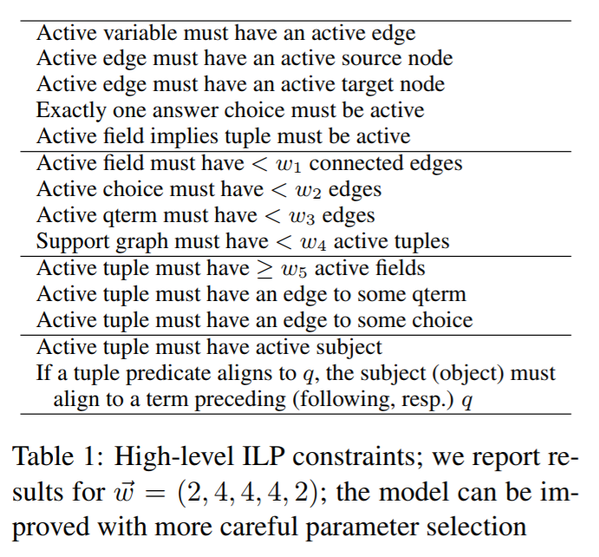
(Aristo): Answering Complex Questions Using Open Information Extraction
The constraints:
Define active node/edge
Bound the number of edges
Tok(qa), not just Tok(q)
Privilege certain tokens
Khot, et al. “Answering Complex Questions Using Open Information Extraction.” ACL 2017. 19 April 2017.

Slide 57
(Aristo): Answering Complex Questions Using Open Information Extraction
High level goal (linear programming optimization):
Optimize this objective function for the variables representing the nodes and edges of the graph we described under the given constraints.
Experiments:
Two question sets: 4th grade (1220 training questions) and 8th grade (293 training questions)
Two knowledge sources: Sentence corpus (80K sentences) and curated tables (7600 rows)
Khot, et al. “Answering Complex Questions Using Open Information Extraction.” ACL 2017. 19 April 2017.

Slide 58
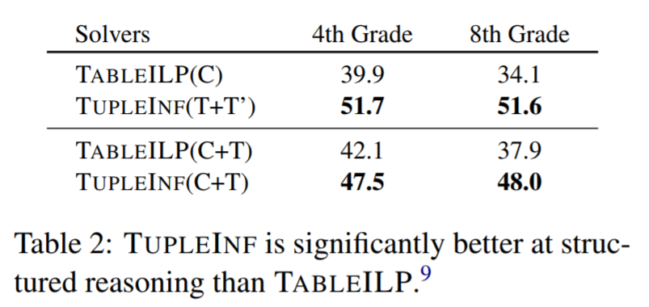
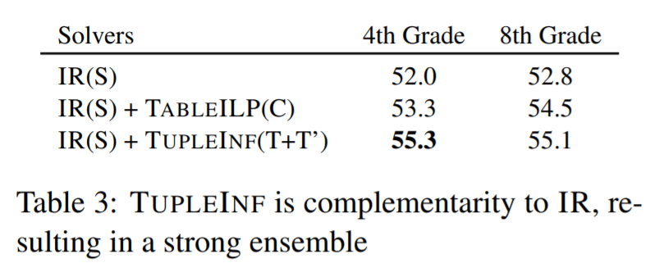
(Aristo): Answering Complex Questions Using Open Information Extraction
Results:
Khot, et al. “Answering Complex Questions Using Open Information Extraction.” ACL 2017. 19 April 2017.

Slide 59
(Aristo): Answering Complex Questions Using Open Information Extraction
Opportunities for improvement:
Missing keywords
The weighting scheme can inadvertently over privilege insignificant, low-frequency words.
Lossy IE
Tuple generation excludes many sentences based on length (too long) and structure.
Bad alignment
Tuple generation removes negated sentences, but some other nuanced differences in meaning
Inference
This model does not support question answering on information outside the scope of the Open IE knowledge base.
Khot, et al. “Answering Complex Questions Using Open Information Extraction.” ACL 2017. 19 April 2017.

Slide 60
(Aristo): Answering Complex Questions Using Open Information Extraction
Summary:
This paper proposes a new state of the art for answering complex questions over Open IE knowledge bases.
Particularly successful on datasets containing middle-school level multiple-choice science questions.
This method is easily extensible:
Can be used for questions at higher grade levels.
Can be improved by refining tuple generation techniques.
Khot, et al. “Answering Complex Questions Using Open Information Extraction.” ACL 2017. 19 April 2017.

Slide 61
Additional Areas of Exploration
McCann, et al. “The Natural Language Decathlon: Multitask Learning as Question Answering.” 20 June 2018.
Dunn, et al. “SearchQA: A New Q&A Dataset Augmented with Context from a Search Engine.” 11 June 2017.
Angeli, et al. “Combining Natural Logic and Shallow Reasoning for Question Answering.” 2016.
Andreas, et al. “Learning to Compose Neural Networks for Question Answering.” 2016.
Iyyer, et al. “Answering Complicated Question Intents Expressed in Decomposed Question Sequences.” 2016.
Kumar, et al. “Ask Me Anything: Dynamic Memory Networks for Natural Language Processing.” 2015.
Bordes, et al. “Large-scale Simple Question Answering with Memory Networks.” 2015.
Notes:
http://www.chengzhan.me/2018/03/15/DrQA/

Slide 62
Discussion Questions
QA is AI-complete, thus if QA is solved, then so is every other problem in AI. What does it mean for question answering to be solved? At what point are we content with the quality of QA technology?
In what ways might the particular application of each paper have heightened the success of the proposed model?
E.g. Did QANTA succeed specifically because it was applied to pyramidal questions?
To what extent are the models presented in these papers extensible to other datasets, applications, and NLP tasks?

Slide 63
Bibliography
Bert F. Green, Jr., Alice K. Wolf, Carol Chomsky, and Kenneth Laughery. 1961. Baseball: an automatic question-answerer. In Papers presented at the May 9-11, 1961, western joint IRE-AIEE-ACM computer conference (IRE-AIEE-ACM '61 (Western)). ACM, New York, NY, USA, 219-224.
Clark, et al. 2016. “Combining retrieval, statistics, and inference to answer elementary science questions.” The Thirtieth AAAI Conference on Artificial Intelligence (AAAI'16). AAAI Press 2580-2586.
Dang, et al.. “Overview of the TREC 2007 Question Answering Track.” National Institute of Standards and Technology. 2007.
Dang, Hoa Trang. “Text REtrieval Conference (TREC) Question Answering Tasks and Evaluation Methods.”National Institute of Standards and Technology. April 27, 2007.
Hermann, Karl M. “Deep Learning for Natural Language Processing: Question Answering.” Google DeepMind. 4 March 2017.
Iyyer, Mohit et al. “A Neural Network for Factoid Question Answering Over Paragraphs.” 2014.
Jurafsky, Daniel. Martin, James H. “Speech and Language Processing.” Third Edition. 15 August 2018: p. 376.
Khot, et al. “Answering Complex Questions Using Open Information Extraction.” ACL 2017. 19 April 2017.
Maskey, Sameer. Rosenberg, Andrew. “Power Mean Pyramid Scores for Summarization Evaluation.” 2012.
McCann, et al. “The Natural Language Decathlon: Multitask Learning as Question Answering.” 20 June 2018.
NIST. “Text REtrieval Conference: Overview.” Retrieved from: https://trec.nist.gov/overview.html.
Pasupat, Panupong. “WikiTableQuestions: A Complex Real-World Question Answering Dataset.” The Stanford NLP Group. 11 February 2016.
L. Hirschman and R. Gaizauskas, ``Natural language question answering: the view from here,'' Natural Language Engineering, vol. 7, no. 4, pp. 275-300, 2001.

Slide 64
Bibliography
Rajpurkar, Pranav. Zhang, Jian. Lopyrev, Konstantin. Liang, Percy. “SQuAD: 100,000+ Questions for Machine Comprehension of Text.” Stanford University, Computer Science Department. 11 October 2016.
“Stanford Open Information Extraction” The Stanford Natural Language Processing Group. Retrieved from: https://nlp.stanford.edu/software/openie.html#Usage
Upbin, Bruce. “IBM’s Watson Gets Its First Piece of Business in Healthcare.” Forbes. 8 February 2013.
Wikipedia contributors. "Watson (computer)." Wikipedia, The Free Encyclopedia. Wikipedia, The Free Encyclopedia, 4 Oct. 2018.
Dunn, et al. “SearchQA: A New Q&A Dataset Augmented with Context from a Search Engine.” 11 June 2017.
Gabor Angeli, Neha Nayak, Christopher D. Manning. “Combining Natural Logic and Shallow Reasoning for Question Answering.” 2016.
Caiming Xiong, Victor Zhong, Richard Socher. “Dynamic Coattention Networks For Question Answering.” 2016.
Ankit Kumar, Ozan Irsoy, Jonathan Su, James Bradbury, Robert English, Brian Pierce, Peter Ondruska, Ishaan Gulrajani, Richard Socher. “Ask Me Anything: Dynamic Memory Networks for Natural Language Processing.” 2015.
Klein, Dan. “Natural Language Processing: Question Answering.” UC Berkeley.
Mohit Iyyer, Wen-tau Yih, Ming-Wei Chang. “Answering Complicated Question Intents Expressed in Decomposed Question Sequences.” 2016.
Antoine Bordes, Nicolas Usunier, Sumit Chopra, Jason Weston. “Large-scale Simple Question Answering with Memory Networks.” 2015.
Jacob Andreas, Marcus Rohrbach, Trevor Darrell, Dan Klein. “Learning to Compose Neural Networks for Question Answering.” 2016.

Slide 65
Thank you

